Slide 1
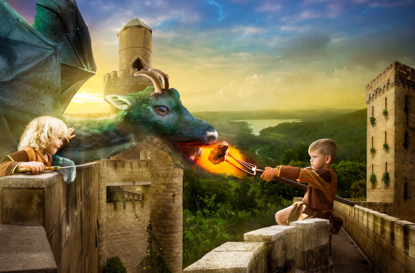
Dangerous pet
Photo courtesy of Karen Alsop, www.storyart.com.au
Activities Pobble 365
Story starter!
The King had known that the gift he presented to his children on their 5th birthday was dangerous. He was prepared to take the risk of letting them own a pet dragon, however. One day, the twins would rule the kingdom together, and they would need all the help they could get. No-one could deny that a dragon was a powerful ally!
Before that day, though, the children had much work to do. They had to train their dragon!
Question time!
Why has the King given his children a dragon?
Do you think it’s a wise decision?
What do you think the children will try and train their dragon to do?
Can you think of any strategies that the children might use to train their dragon?
Where do the children live?
Can you think of a good name for their kingdom?
Why do you think the children will need ‘all the help they can get’ when they come to rule?
Can you think of names for the children?
What is the boy feeding the dragon?
What do you think the girl is carrying?

Slide 2
Dangerous pet
Photo courtesy of Karen Alsop, www.storyart.com.au ,
Activities Pobble 365
Story starter!
The King had known that the gift he presented to his children on their 5th birthday was dangerous. He was prepared to take the risk of letting them own a pet dragon, however. One day, the twins would rule the kingdom together, and they would need all the help they could get. No-one could deny that a dragon was a powerful ally!
Before that day, though, the children had much work to do. They had to train their dragon!
Perfect picture!
Think about what the children will teach the dragon. Can you draw them teaching him a certain skill?

Slide 3
Dangerous pet
Photo courtesy of Karen Alsop, www.storyart.com.au
Activities Pobble 365
Story starter!
The King had known that the gift he presented to his children on their 5th birthday was dangerous. He was prepared to take the risk of letting them own a pet dragon, however. One day, the twins would rule the kingdom together, and they would need all the help they could get. No-one could deny that a dragon was a powerful ally!
Before that day, though, the children had much work to do. They had to train their dragon!
Sick sentences!
These sentences are ‘sick’ and need help to get better. Can you help?
The boy held out some food. The dragon ate it. He was green and had horns.
Sentence challenge!
Can you make a list of adjectives to describe the dragon?
Can you make a list of verbs to say what the dragon is doing?
Can you make a list of adverbs to describe how the dragon is eating?
Can you now write a sentence using a verb, an adverb and at least one adjectives?

Slide 4
Dangerous pet
Photo courtesy of Karen Alsop, www.storyart.com.au
Activities Pobble 365
Story starter!
The King had known that the gift he presented to his children on their 5th birthday was dangerous. He was prepared to take the risk of letting them own a pet dragon, however. One day, the twins would rule the kingdom together, and they would need all the help they could get. No-one could deny that a dragon was a powerful ally!
Before that day, though, the children had much work to do. They had to train their dragon!
Can you finish their story.
Remember to write in third person, just like the story starter and use lots of well chosen adjectives.

Slide 5
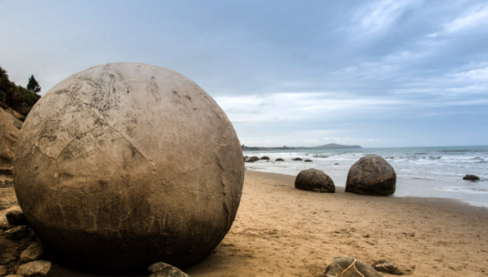
About to hatch
Photo courtesy of One Big Photo
Activities Pobble 365
Story starter!
For the last few days, they had been falling from the sky. Nobody knew where they had come from; nobody knew why they were there.
The mysterious objects, most of them spherical in shape, lay there on the beach, motionless, immovable despite the tide’s best efforts to eradicate them from the shoreline.
Then, a crack began to appear on the surface…
Question time!
Where might these objects have come from?
Why is the surface of the nearest object cracking?
What is inside the objects? Are they all the same?
What will happen next?
If you came across one of these, how would you react?
Do these objects remind you of anything?
Why have these objects landed on the beach? Is it by chance or is it deliberate?

Slide 6
About to hatch
Photo courtesy of One Big Photo
Activities Pobble 365
Story starter!
For the last few days, they had been falling from the sky. Nobody knew where they had come from; nobody knew why they were there.
The mysterious objects, most of them spherical in shape, lay there on the beach, motionless, immovable despite the tide’s best efforts to eradicate them from the shoreline.
Then, a crack began to appear on the surface…
Perfect picture!
The object in the picture is beginning to crack and open. Can you draw whatever is inside?

Slide 7
About to hatch
Photo courtesy of One Big Photo
Activities Pobble 365
Story starter!
For the last few days, they had been falling from the sky. Nobody knew where they had come from; nobody knew why they were there.
The mysterious objects, most of them spherical in shape, lay there on the beach, motionless, immovable despite the tide’s best efforts to eradicate them from the shoreline.
Then, a crack began to appear on the surface…
Sentence challenge!
Verbs are action/doing words.
Look at my writing below. Can you locate the verbs and replace them with more exciting vocabulary? Can you add some adverbs to the sentences too?
Out of nowhere, oddly shaped objects came down from the sky. They went into the sand with a loud thump.
A group of people walking along the beach saw the objects, and walked towards them.
A crack went on the surface, and the gathering crowd made a noise.
Sick sentences!
These sentences are ‘sick’ and need help to get better. Can you help?
The rock was on the beach. It was round. It was big.

Slide 8
About to hatch
Photo courtesy of One Big Photo
Activities Pobble 365
Story starter!
For the last few days, they had been falling from the sky. Nobody knew where they had come from; nobody knew why they were there.
The mysterious objects, most of them spherical in shape, lay there on the beach, motionless, immovable despite the tide’s best efforts to eradicate them from the shoreline.
Then, a crack began to appear on the surface…
Can you complete the opening paragraph to this story? Remember to focus on this weeks sentence challenge and include exciting verbs and adverbs.

Slide 9
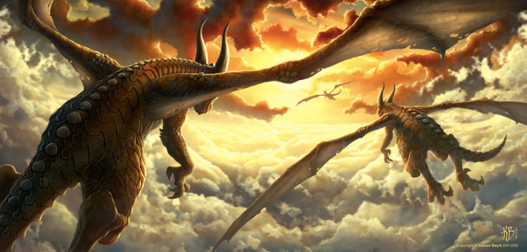
About to hatch
Photo courtesy of Kerem Beyit
Activities Pobble 365
Story starter!
This was their favourite time of day to fly.
As the glowing, crimson sun dipped down below the vast horizon, retreating to allow night to take its place, the dragons took flight.
The sky looked beautiful: wisps of pillow-like clouds seemed to part in front of them as they flexed their powerful wings. Like sails from ancient ships, the wings beat in the dying embers of the sun’s fire, embracing what little warmth remained. Thousands of tiny scales that covered the beasts’ bodies glistened like rubies in the dazzling light.
As they reached full speed, leaving the world far beneath them, they almost grinned as they thought about where they were going. There would be others like them there. It would be paradise…
Question time!
Where are the dragons heading?
What is ‘paradise’? Why are they looking forward to it so much?
Are these the only 3 dragons that exist, or are there more?
Where have the dragons come from? Where is their home?
If you had a pet baby dragon, how would you look after it?

Slide 10
About to hatch
Photo courtesy of Kerem Beyit
Activities Pobble 365
Story starter!
This was their favourite time of day to fly.
As the glowing, crimson sun dipped down below the vast horizon, retreating to allow night to take its place, the dragons took flight.
The sky looked beautiful: wisps of pillow-like clouds seemed to part in front of them as they flexed their powerful wings. Like sails from ancient ships, the wings beat in the dying embers of the sun’s fire, embracing what little warmth remained. Thousands of tiny scales that covered the beasts’ bodies glistened like rubies in the dazzling light.
As they reached full speed, leaving the world far beneath them, they almost grinned as they thought about where they were going. There would be others like them there. It would be paradise…
Perfect picture!
Can you draw what you think a dragon’s home might look like? Think carefully about what dragons are fond of.

Slide 11
About to hatch
Photo courtesy of Kerem Beyit
Activities Pobble 365
Story starter!
This was their favourite time of day to fly.
As the glowing, crimson sun dipped down below the vast horizon, retreating to allow night to take its place, the dragons took flight.
The sky looked beautiful: wisps of pillow-like clouds seemed to part in front of them as they flexed their powerful wings. Like sails from ancient ships, the wings beat in the dying embers of the sun’s fire, embracing what little warmth remained. Thousands of tiny scales that covered the beasts’ bodies glistened like rubies in the dazzling light.
As they reached full speed, leaving the world far beneath them, they almost grinned as they thought about where they were going. There would be others like them there. It would be paradise…
Sentence challenge!
A simile is a way of describing something by comparing it to something else, often using the word "like" or "as."
Can you identify all of the similes in my writing?
Can you think of your own similes to use in your writing?
In your writing tomorrow experiment using similes, or even personification to make your writing really exciting to read.
Sick sentences!
These sentences are ‘sick’ and need help to get better. Can you help? Could you add an adverb?
The dragon flew through the sky. The sun was shining in the sky. There were big clouds.

Slide 12
About to hatch
Photo courtesy of Kerem Beyit
Activities Pobble 365
Story starter!
This was their favourite time of day to fly.
As the glowing, crimson sun dipped down below the vast horizon, retreating to allow night to take its place, the dragons took flight.
The sky looked beautiful: wisps of pillow-like clouds seemed to part in front of them as they flexed their powerful wings. Like sails from ancient ships, the wings beat in the dying embers of the sun’s fire, embracing what little warmth remained. Thousands of tiny scales that covered the beasts’ bodies glistened like rubies in the dazzling light.
As they reached full speed, leaving the world far beneath them, they almost grinned as they thought about where they were going. There would be others like them there. It would be paradise…
Story challenge
Finish this dragon story in this person.
Remember to include similes and perhaps even some personification to excite your reader.

Slide 13
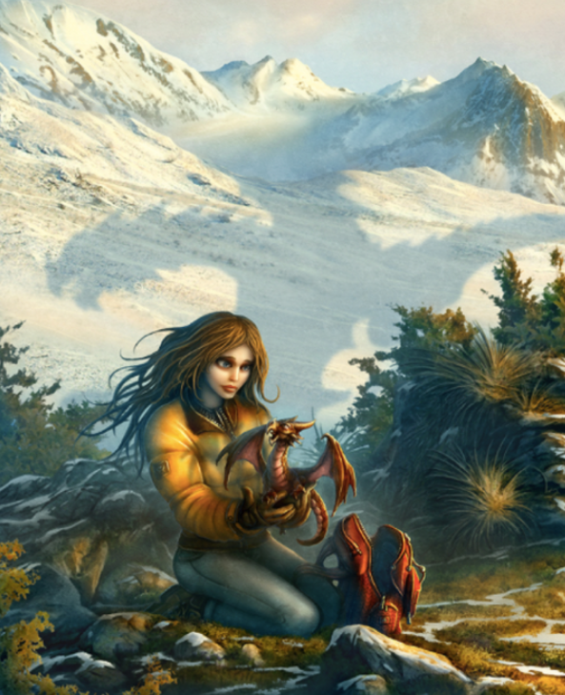
About to hatch
Story starter!
When the dragon had hatched, crawling out of its shell onto her bed, Zoya knew that her life would never be the same again.
She had brought the dragon far away from her village; away from the people who would hurt it and take it away from her. As she held it in her hands, feeling its claws affectionately digging into her fingers through her gloves, Zoya knew that exactly what she had to do. What they had to do. Together.
The dragon gazed at her. She could see the flames burning within its eyes. It was totally dependant on her, as a new-born child is to its mother. And yet, strangely, she felt dependant upon the dragon as well; dependant upon what it was and what it would become in time.
They would become inseparable. Their futures were entwined. Their adventures were only just beginning…
Question time!
Where do you think Zoya got the dragon egg?
How did she get it to hatch?
Why has Zoya left home?
Did she tell anyone about the dragon?
What do you think she is planning to do with the dragon?
Photo courtesy of Kerem Beyit www.kerembeyit.deviantart.com
Activities Pobble 365
Where is she taking it?
Are there other dragons like it?
How will she feed it?
What is causing the shadow in the snow behind her?

Slide 14
About to hatch
Story starter!
When the dragon had hatched, crawling out of its shell onto her bed, Zoya knew that her life would never be the same again.
She had brought the dragon far away from her village; away from the people who would hurt it and take it away from her. As she held it in her hands, feeling its claws affectionately digging into her fingers through her gloves, Zoya knew that exactly what she had to do. What they had to do. Together.
The dragon gazed at her. She could see the flames burning within its eyes. It was totally dependant on her, as a new-born child is to its mother. And yet, strangely, she felt dependant upon the dragon as well; dependant upon what it was and what it would become in time.
They would become inseparable. Their futures were entwined. Their adventures were only just beginning…
Perfect picture!
Can you draw a dragon’s egg? How big do you think it would be compared to a hen’s egg? What colour (s) would it be?
Photo courtesy of Kerem Beyit www.kerembeyit.deviantart.com
Activities Pobble 365

Slide 15
About to hatch
Story starter!
When the dragon had hatched, crawling out of its shell onto her bed, Zoya knew that her life would never be the same again.
She had brought the dragon far away from her village; away from the people who would hurt it and take it away from her. As she held it in her hands, feeling its claws affectionately digging into her fingers through her gloves, Zoya knew that exactly what she had to do. What they had to do. Together.
The dragon gazed at her. She could see the flames burning within its eyes. It was totally dependant on her, as a new-born child is to its mother. And yet, strangely, she felt dependant upon the dragon as well; dependant upon what it was and what it would become in time.
They would become inseparable. Their futures were entwined. Their adventures were only just beginning…
Photo courtesy of Kerem Beyit www.kerembeyit.deviantart.com
Activities Pobble 365
Sentence challenge!
Can you write a sentence that uses an apostrophe for omission?
E.g. can not = can’t I have = I’ve he will= he’ll she is= she’s we have= we’ve will not = won’t
Can you write a sentence that uses an apostrophe for possession?
E..g. The dragon’s scales.
Sick sentences!
These sentences are ‘sick’ and need help to get better. Can you help? Could you add an adverb?
Zoya held the dragon in her hands. It had scales and wings. It had a beak and horns. She felt excited

Slide 16
About to hatch
Story starter!
When the dragon had hatched, crawling out of its shell onto her bed, Zoya knew that her life would never be the same again.
She had brought the dragon far away from her village; away from the people who would hurt it and take it away from her. As she held it in her hands, feeling its claws affectionately digging into her fingers through her gloves, Zoya knew that exactly what she had to do. What they had to do. Together.
The dragon gazed at her. She could see the flames burning within its eyes. It was totally dependant on her, as a new-born child is to its mother. And yet, strangely, she felt dependant upon the dragon as well; dependant upon what it was and what it would become in time.
They would become inseparable. Their futures were entwined. Their adventures were only just beginning…
Photo courtesy of Kerem Beyit www.kerembeyit.deviantart.com
Activities Pobble 365
Complete the story of Zoya and her dragon.
My challenge is to include 1 personification, 2 similes, and 3 contractions using apostrophes of omission.

Slide 17
The Eye
Photo courtesy of
Photo : Photo courtesy of Dennis Stewart, One Big Photo.
Activities Pobble 365
Story starter!
In the sweltering depths of the misty marsh, it lay there. Waiting.
The eye was as green as the grass in a garden on a summer day, but much more deadly. It was speckled with gold, like the brightest stars shimmering in the sky at night, but much more deadly.
As if in a peaceful slumber, the creature stretched itself out, scales covering its body from snout to tail.
It lay there, waiting
Question time!
To what creature do you think the
eye belongs?
Is the creature dangerous?
Where do you think it lives?
What might it be looking at?
What do you think it eats?
In what way is this eye similar to yours? How is it different?
Who do you think might have taken this photograph?

Slide 18
The Eye
Story starter!
In the sweltering depths of the misty marsh, it lay there. Waiting.
The eye was as green as the grass in a garden on a summer day, but much more deadly. It was speckled with gold, like the brightest stars shimmering in the sky at night, but much more deadly.
As if in a peaceful slumber, the creature stretched itself out, scales covering its body from snout to tail.
It lay there, waiting
Perfect picture!
Imagine what the rest of this creature looks like. Draw or describe what you have imagined.

Slide 19
The Eye
Story starter!
In the sweltering depths of the misty marsh, it lay there. Waiting.
The eye was as green as the grass in a garden on a summer day, but much more deadly. It was speckled with gold, like the brightest stars shimmering in the sky at night, but much more deadly.
As if in a peaceful slumber, the creature stretched itself out, scales covering its body from snout to tail.
It lay there, waiting.
Photo courtesy of
Photo : Photo courtesy of Dennis Stewart, One Big Photo.
Activities Pobble 365
Sentence challenge!
A parenthesis is a word or a phrase put into a sentence to
give it more information.
Sometimes a parenthesis is in italics, sometimes it is in (brackets), sometimes there is a dash – and sometimes it has ‘inverted
commas’ around it.
Parentheses are used to:
Explain what a difficult word means.
Show someone’s thoughts
Add extra information to help the reader
Emphasise a point
Can you use brackets to add extra information?
E.g. His scales (covering his body from snout to tail) were two inches thick.
Sick sentences!
These sentences are ‘sick’ and need help to get better. Can you help?
The big creature crawled out of the swamp. He had a big eye and scales on his big body.

Slide 20
The Eye
Story starter!
In the sweltering depths of the misty marsh, it lay there. Waiting.
The eye was as green as the grass in a garden on a summer day, but much more deadly. It was speckled with gold, like the brightest stars shimmering in the sky at night, but much more deadly.
As if in a peaceful slumber, the creature stretched itself out, scales covering its body from snout to tail.
It lay there, waiting
What could happen as this story unfolds?
Draw a story graph to show your thoughts . Use the graph on the next slide to help.

Slide 21
The Eye
Story starter!
In the sweltering depths of the misty marsh, it lay there. Waiting.
The eye was as green as the grass in a garden on a summer day, but much more deadly. It was speckled with gold, like the brightest stars shimmering in the sky at night, but much more deadly.
As if in a peaceful slumber, the creature stretched itself out, scales covering its body from snout to tail.
It lay there, waiting.

Slide 22
The Unseen
Story starter!
Have you ever wondered what stars are for? Have you ever wondered why the wind blows?
It’s all for them.
When the world sleeps, they awaken. When we close our eyes, they open theirs. All around us, ever present yet unseen, they exist. Their home is the stars. Earth is their playground. This is their story…
Question time!
Do you think it is possible that we are not alone in the Universe?
How do you think their flag became torn?
How do you think they move around in the sky?
Where do you think the plane in the background is going?
Photo courtesy of Alexander JanssonActivities Pobble 365

Slide 23
The Unseen
Story starter!
Have you ever wondered what stars are for? Have you ever wondered why the wind blows?
It’s all for them.
When the world sleeps, they awaken. When we close our eyes, they open theirs. All around us, ever present yet unseen, they exist. Their home is the stars. Earth is their playground. This is their story…
Perfect picture!
Imagine where these ‘visitors’ live. Can you draw or describe their home?
Photo courtesy of Alexander JanssonActivities Pobble 365

Slide 24
The Unseen
Photo courtesy of Alexander JanssonActivities Pobble 365
Story starter!
Have you ever wondered what stars are for? Have you ever wondered why the wind blows?
It’s all for them.
When the world sleeps, they awaken. When we close our eyes, they open theirs. All around us, ever present yet unseen, they exist. Their home is the stars. Earth is their playground. This is their story…
Sick sentences!
These sentences are ‘sick’ and need help to get better. Can you help?
The big flag blew in the wind. Their boat went through the night sky.
Sentence challenge!
Anxiliary verbs is used to express intention for the future.
Which option completes the sentence below?
I wish I __________see these mysterious visitors that come out at night
can
will
Could Rewrite the sentence placing in your choice

Slide 25
The Unseen
Story starter!
Have you ever wondered what stars are for? Have you ever wondered why the wind blows?
It’s all for them.
When the world sleeps, they awaken. When we close our eyes, they open theirs. All around us, ever present yet unseen, they exist. Their home is the stars. Earth is their playground. This is their story…
Can you continue the story about these mysterious visitors?
Photo courtesy of Alexander JanssonActivities Pobble 365

Slide 26
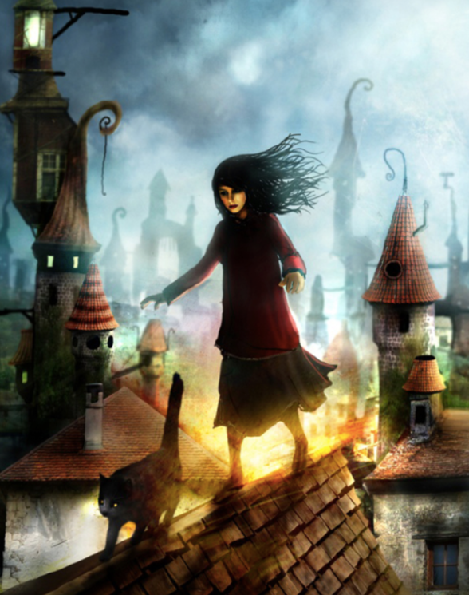
Secret Magic
Photo courtesy of Alexander JanssonActivities Pobble 365
Story starter!
Bella had always been different from the other children at school. They looked at her strangely, and she would often hear them whispering about her when they thought she wasn’t there. Sometimes they whispered about her even when they knew she was listening.
Every evening when Bella returned home, her real life began. The everyday worries of school and other children were banished from her mind. Bella had another life. A life that was secret. A life that was magical.
As she clambered over the rooftops, with her trusted and faithful companion, she could feel the magic coursing through her body. It warmed her, like the glowing embers of a comforting fire.
Question time!
Can you continue the story? Where are Bella and her companion going?
What does ‘companion’ mean?
Who is Bella’s companion?
Do you think Bella’s cat is a ‘normal’ animal?
What are Bella’s magical powers?
Where is she going?
Do you think her family know about her powers?
If you were Bella, how would you use your magical powers?
Why is she walking along rooftops?

Slide 27
Secret Magic
Story starter!
Bella had always been different from the other children at school. They looked at her strangely, and she would often hear them whispering about her when they thought she wasn’t there. Sometimes they whispered about her even when they knew she was listening.
Every evening when Bella returned home, her real life began. The everyday worries of school and other children were banished from her mind. Bella had another life. A life that was secret. A life that was magical.
As she clambered over the rooftops, with her trusted and faithful companion, she could feel the magic coursing through her body. It warmed her, like the glowing embers of a comforting fire.
Perfect picture!
Can you draw a picture of Bella using one of her magical powers?
Photo courtesy of Alexander JanssonActivities Pobble 365

Slide 28
Secret Magic
Photo courtesy of Alexander JanssonActivities Pobble 365
Story starter!
Bella had always been different from the other children at school. They looked at her strangely, and she would often hear them whispering about her when they thought she wasn’t there. Sometimes they whispered about her even when they knew she was listening.
Every evening when Bella returned home, her real life began. The everyday worries of school and other children were banished from her mind. Bella had another life. A life that was secret. A life that was magical.
As she clambered over the rooftops, with her trusted and faithful companion, she could feel the magic coursing through her body. It warmed her, like the glowing embers of a comforting fire.
Sick sentences!
These sentences are ‘sick’ and need help to get better. Can you help?
Bella walked over the tiles. She held her arms out. Her hair blew in the wind.
Sentence challenge!
Can you write a compound sentence, where a colon separates two independent clauses?
The first independent clause describes something and the second gives extra detail.
Bella had magic in her fingertips: for years she had performed the most incredible feats.

Slide 29
Secret Magic
Story starter!
Bella had always been different from the other children at school. They looked at her strangely, and she would often hear them whispering about her when they thought she wasn’t there. Sometimes they whispered about her even when they knew she was listening.
Every evening when Bella returned home, her real life began. The everyday worries of school and other children were banished from her mind. Bella had another life. A life that was secret. A life that was magical.
As she clambered over the rooftops, with her trusted and faithful companion, she could feel the magic coursing through her body. It warmed her, like the glowing embers of a comforting fire.
All of a sudden she felt alive. Tonight was going to be a night to remember…
Finish Bella’s story.
Photo courtesy of Alexander JanssonActivities Pobble 365

Slide 30
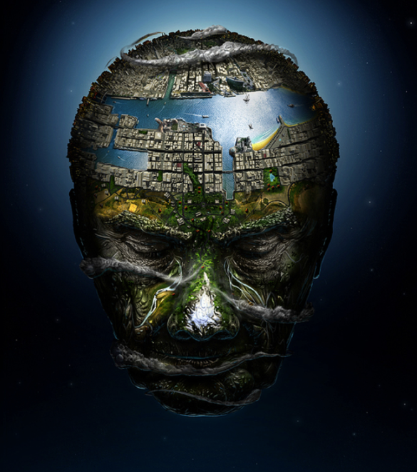
The head of the world
Story starter!
He was the World.
His nose was like an enormous, ice-tipped mountain.
His forehead was a mighty river flowing across his brow.
His eyes were like deep canyons; colossal gouges chiselled from his rocky face.
His tears were waterfalls cascading down his grassy cheeks.
He was the World.
Question time!
If you chose to live on one part of the Head, where would it be?
If this was where we lived, what would happen when the Head awoke?
What do you think would be inside his mouth and eyes?
What do you think is causing the light around him?
Do you think there is a reason why the artist has created such a strange and abstract image?
Is there a deeper meaning behind it?
Photo courtesy of Jerico Santander ,
Activities Pobble 365

Slide 31
The head of the world
Story starter!
He was the World.
His nose was like an enormous, ice-tipped mountain.
His forehead was a mighty river flowing across his brow.
His eyes were like deep canyons; colossal gouges chiselled from his rocky face.
His tears were waterfalls cascading down his grassy cheeks.
He was the World.
Perfect picture!
Imagine what the back of his head looks like. Can you draw or describe what you have imagined?
Alternatively, you could design your own version of the Head of the World.
Photo courtesy of Jerico Santander ,
Activities Pobble 365

Slide 32
The head of the world
Story starter!
He was the World.
His nose was like an enormous, ice-tipped mountain.
His forehead was a mighty river flowing across his brow.
His eyes were like deep canyons; colossal gouges chiselled from his rocky face.
His tears were waterfalls cascading down his grassy cheeks.
He was the World.
Sick sentences!
These similes and metaphors are ‘sick’ and need help to get better. Can you help?
His nose was like a mountain. His eyes were like valleys. His forehead was a city. His eyebrows were walls.
Sentence challenge!
Can you identify all of the similes and metaphors in my short poem?
Can you think of your own similes and metaphors that could be used. Make a list.
Photo courtesy of Jerico Santander ,
Activities Pobble 365

Slide 33
The head of the world
Story starter!
He was the World.
His nose was like an enormous, ice-tipped mountain.
His forehead was a mighty river flowing across his brow.
His eyes were like deep canyons; colossal gouges chiselled from his rocky face.
His tears were waterfalls cascading down his grassy cheeks.
He was the World.
Can you continue the poem?
Use the list of your own similes and metaphors from yesterday.
Photo courtesy of Jerico Santander ,
Activities Pobble 365

Slide 34
The Fuzzle
Story starter!
Far away from here, in a distant land that few people have heard the name of before (let alone visited), there lives a fuzzle. Well, fuzzles, to be exact. You see, there is a family of them!
Shy and elusive creatures, fuzzles keep themselves to themselves, and therefore are rarely seen by human beings. Their fuzzlets (young fuzzles) are even shyer, but have been spotted occasionally clinging onto their mother’s back.
As you have probably guessed, this is a story all about fuzzles. You are about to find out what extraordinary creatures they really are…
Photo courtesy of Alexander Jansson Activities Pobble 365
How big do you think they are?
What are fuzzles good at?
What are their homes like?
Question time!
What kind of creature do you think a fuzzle is?
Is it similar to any other animals you know?
What do you think fuzzles eat?
Are they friendly towards humans?

Slide 35
The Fuzzle
Photo courtesy of Alexander Jansson
Activities Pobble 365
Story starter!
Far away from here, in a distant land that few people have heard the name of before (let alone visited), there lives a fuzzle. Well, fuzzles, to be exact. You see, there is a family of them!
Shy and elusive creatures, fuzzles keep themselves to themselves, and therefore are rarely seen by human beings. Their fuzzlets (young fuzzles) are even shyer, but have been spotted occasionally clinging onto their mother’s back.
As you have probably guessed, this is a story all about fuzzles. You are about to find out what extraordinary creatures they really are…
Perfect picture!
Can you invent your own creature? You could combine two animals to make one strange animal! Draw/describe what your animal is like.

Slide 36
The Fuzzle
Story starter!
Far away from here, in a distant land that few people have heard the name of before (let alone visited), there lives a fuzzle. Well, fuzzles, to be exact. You see, there is a family of them!
Shy and elusive creatures, fuzzles keep themselves to themselves, and therefore are rarely seen by human beings. Their fuzzlets (young fuzzles) are even shyer, but have been spotted occasionally clinging onto their mother’s back.
As you have probably guessed, this is a story all about fuzzles. You are about to find out what extraordinary creatures they really are…
Sick sentences!
These sentences are ‘sick’ and need help to get better. Can you help? Could you add an adverb?
Fuzzles are big creatures. Their fuzzlets are small. They often ride bikes to get to places.
Photo courtesy of Alexander Jansson
Activities Pobble 365
Sentence Challenge:
A parenthesis is a word or a phrase put into a sentence to give it more information.
Sometimes a parenthesis is in italics, sometimes it is in (brackets), sometimes there is a dash – and sometimes it has ‘inverted commas’ around it.
Parentheses are used to:
Explain what a difficult word means.
Show someone’s thoughts
Add extra information to help the reader
Emphasise a point
Can you write two sentences , using brackets to add extra information?
E.g. Fuzzles (which are rarely seen by humans) have long fur.

Slide 37
The Fuzzle
Photo courtesy of Alexander Jansson
Activities Pobble 365
Story starter!
Far away from here, in a distant land that few people have heard the name of before (let alone visited), there lives a fuzzle. Well, fuzzles, to be exact. You see, there is a family of them!
Shy and elusive creatures, fuzzles keep themselves to themselves, and therefore are rarely seen by human beings. Their fuzzlets (young fuzzles) are even shyer, but have been spotted occasionally clinging onto their mother’s back.
As you have probably guessed, this is a story all about fuzzles. You are about to find out what extraordinary creatures they really are…
Complete the Fuzzles story as told by someone who first discovered their existence, Professor Hutton.

Slide 38
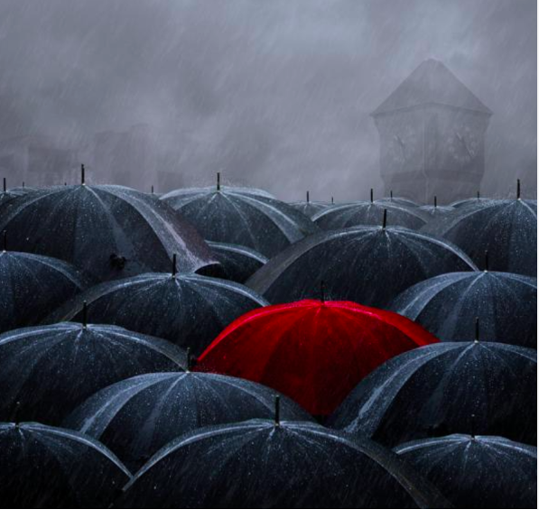
The Clock Tower
Story starter!
They had been waiting outside the clocktower all day. Soon, it would be time.
The cloud spat bullets of rain down upon the expectant crowd, before the droplets bounced off the taut canopies of the hundreds of umbrellas that flooded the cobbled square.
Eager eyes became glued to the long, black hands of the clock face. They seemed to be moving in slow motion, as if reluctant to reach the fateful hour; the fateful hour which would determine all their fates...
Question time!
What is the significance of the clocktower? Is there someone inside?
What does 'the fateful hour' mean? What is it that the crowd are waiting for?
What does the word 'expectant' tell you about how the crowd are feeling?
What will happen when 'the fateful hour' arrives?
Why does only one person carry a red umbrella?
Photo courtesy of JPhoto courtesy of Caras Ionut ,
Activities Pobble 365

Slide 39
The Clock Tower
Story starter!
They had been waiting outside the clocktower all day. Soon, it would be time.
The cloud spat bullets of rain down upon the expectant crowd, before the droplets bounced off the taut canopies of the hundreds of umbrellas that flooded the cobbled square.
Eager eyes became glued to the long, black hands of the clock face. They seemed to be moving in slow motion, as if reluctant to reach the fateful hour; the fateful hour which would determine all their fates...
Perfect picture!
Can you draw what might happen when 'the fateful hour' arrives?
Photo courtesy of JPhoto courtesy of Caras Ionut ,
Activities Pobble 365

Slide 40
The Clock Tower
Story starter!
They had been waiting outside the clocktower all day. Soon, it would be time.
The cloud spat bullets of rain down upon the expectant crowd, before the droplets bounced off the taut canopies of the hundreds of umbrellas that flooded the cobbled square.
Eager eyes became glued to the long, black hands of the clock face. They seemed to be moving in slow motion, as if reluctant to reach the fateful hour; the fateful hour which would determine all their fates...
Photo courtesy of JPhoto courtesy of Caras Ionut ,
Activities Pobble 365
Sentence challenge!
Can you use similes to describe the scene?
The rain poured down like...
The closely packed umbrellas looked like...
The red umbrella stood out like...
The ferules of the umbrellas stood up like...
Sick sentences!
These sentences are 'sick' and need your help to get better.
It was raining. People stood in the rain with their umbrellas. The clocktower stood nearby.

Slide 41
The Clock Tower
Story starter!
They had been waiting outside the clocktower all day. Soon, it would be time.
The cloud spat bullets of rain down upon the expectant crowd, before the droplets bounced off the taut canopies of the hundreds of umbrellas that flooded the cobbled square.
Eager eyes became glued to the long, black hands of the clock face. They seemed to be moving in slow motion, as if reluctant to reach the fateful hour; the fateful hour which would determine all their fates...
Photo courtesy of JPhoto courtesy of Caras Ionut ,
Activities Pobble 365
Finish the story. Remember the Sentence Challenge for your writing today.
Add some similes and metaphors to your writing today.

